Slide 1
Onboarding system
Your one click pitch template
>> Let’s start convince your boss

Slide 2
20% of new hires leave ..for a new opportunity within the first 45 days on the job!

Slide 3
Digital onboarding can reduce new hire turnover by up to 82% and considering the fact that a bad recruitment can cost us up to 100.000€ - then digital onboarding is in fact important for our bottom line.
Digital personalized onboarding has never been more critical! Candidates look for meaningful workplaces and they can pick and choose as they please. Our ability to get talents on board and integrated well into our culture and company as a whole is key to retaining talents now and long term.

Slide 4
Let’s flip that around
Do we want to prevent early leavers?
Do we want to ensure that new hires are engaged and excited about their new job and workplace?
Do we want to speed up time-to-productivity?
Do we want to retain both new and existing employees as long as possible?
Do we want to save time and money on our recruitment and onboarding efforts all together?

Slide 5
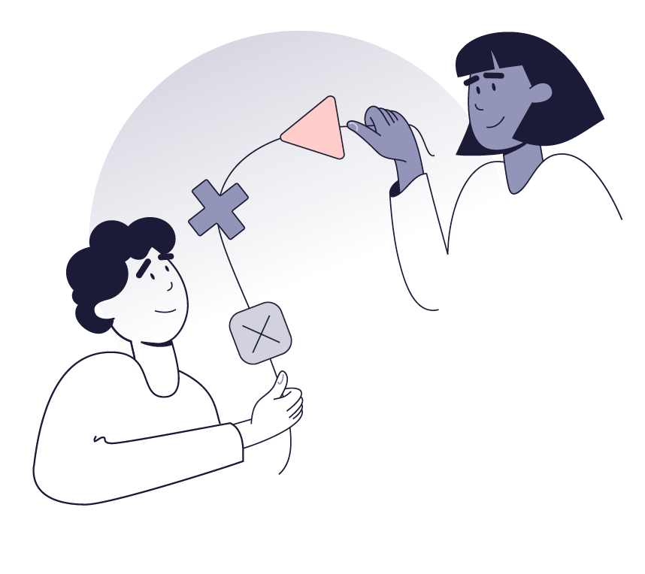
Here’s a way for us to drive engagement, shorten time-to-productivity and increase retention amongst new hires.
Digital onboarding system
With digital onboarding software we can set up personalized and automated pre- and onboarding journeys that enable us to deliver the right training, share knowledge, communicate values, build connections and manage compliance to transform our new hires into confident, empowered team members and ambassadors.

Slide 6
What will this do for us?

Slide 7
7
1
Increase new hire
engagement
With a digital onboarding system we will be able to set up personalized and inspiring pre- and onboarding journeys that drip feed onboardees with information, training and experiences that engage them. Automated task management ensures ongoing check-ins and communication touchpoints that our new hires need.

Slide 8
Investing more in new hire communication and engagement throughout the pre-boarding phase, can improve the onboarding experience by 83%
83%
https://www.thetalentboard.org/benchmark-research/cande-research-reports/

Slide 9
Onboarding show an increase in new hire engagement by up to 33% and engaged employees are 21% more profitable
33%
Harter, J. & Mann, A., The Right Culture: Not Just About Employee Satisfaction, Gallup, 2017

Slide 10
10
2
Shorten
time-to-productivity
With a digital onboarding system we will be able to deliver timed information and training material when new hires need it – without overwhelming them. We’ll be able to preboard them and ensure practical matters are sorted before they start and we can

Slide 11
Good onboarding is proven to shorten “time-to-productivity” by up to 70%
70%
Laurano, M., The True Cost of a Bad Hire, 2013, p.12

Slide 12
66% of new employees list job duties, expectations, and results as their biggest onboarding challenges
66%

Slide 13
Studies show that + 50% of employees say that onboarding shortened their learning curve
+50%

Slide 14
14
3
Increase new hire
retention
With a digital onboarding system we’ll be able to reduce new hire turnover by ensuring and streamlining how we integrate onboardees into our culture and company as a whole. Setting up personalized onboarding journeys will help us give all onboardees a good start with the right training, communication and support the need to thrive from the outset.

Slide 15
72% need to understand the work culture before accepting an offer
72%
https://www.pwc.com/us/en/services/consulting/business-transformation/library/hr-recruiting.html

Slide 16
Pre- and onboarding can help boost new hire retention by up to 82%!
82%
Laurano, M., The True Cost of a Bad Hire, 2013, p.12

Slide 17
17
4
Improve our bottom line
With a digital onboarding system we can minimize the costs of replacing employees. We’ll save time and money on administration and we’ll be able to lift new hire performance, which shows directly on our bottom line.

Slide 18
Organizations that prioritize digital onboarding can reduce non-starters by more than 35%
35%

Slide 19
With automation HR can save up to +5 hours per onboardee in administrative work alone
+5 hours
National CareerBuilder Survey by Harris Poll, CareerBuilder, 2017

Slide 20
Organizations with shorter proficiency learning curves minimize the financial impact of lost productivity on their bottom line by up to 2.5%.
2,5%

Slide 21
To sum up A digital onboarding system will help improve new hire engagement through ongoing communication and storytelling. We’ll be able to shorten time-to-productivity through timed training and check-ins and increase retention by integrating new hires better into our work culture. And ultimately, this will all help us improve our bottom.

Slide 22
…And there is more!

Slide 23
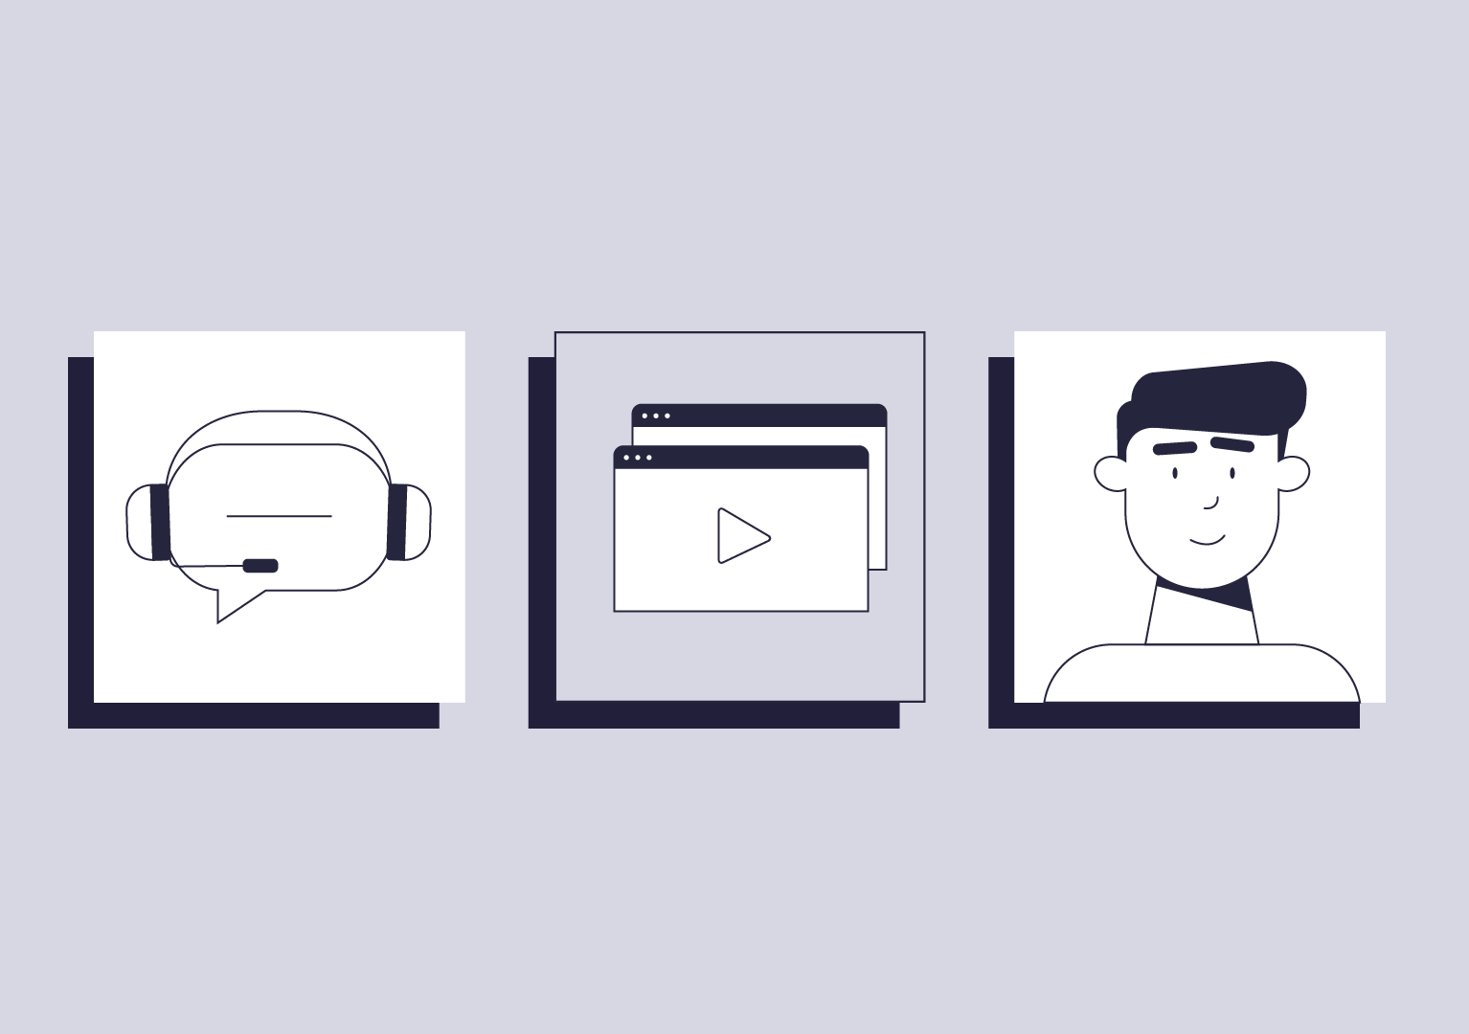
It’s like a digital HR assistant
Digital and automated processes will free up internal resources
No internal IT resources needed for daily usage
We’ll have free local support every day from 8-17
We’ll have access to consultancy if needed

Slide 24
And in case you wonder…
Yes,
It is 100% GDPR compliant
We’ll always have candidate & employee consent
We’ll have deletion policy & user management in place
Vendor is under IT audit by external IT revisions
We’ll have secure data storage
Data processor agreement from vendor is our guarantee

Slide 25
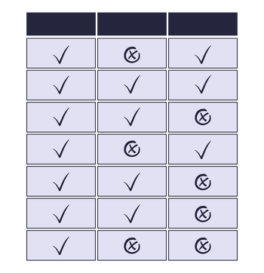
To make it even more simple, I’ve listed the system requirements we need to succeed See overview

Slide 26
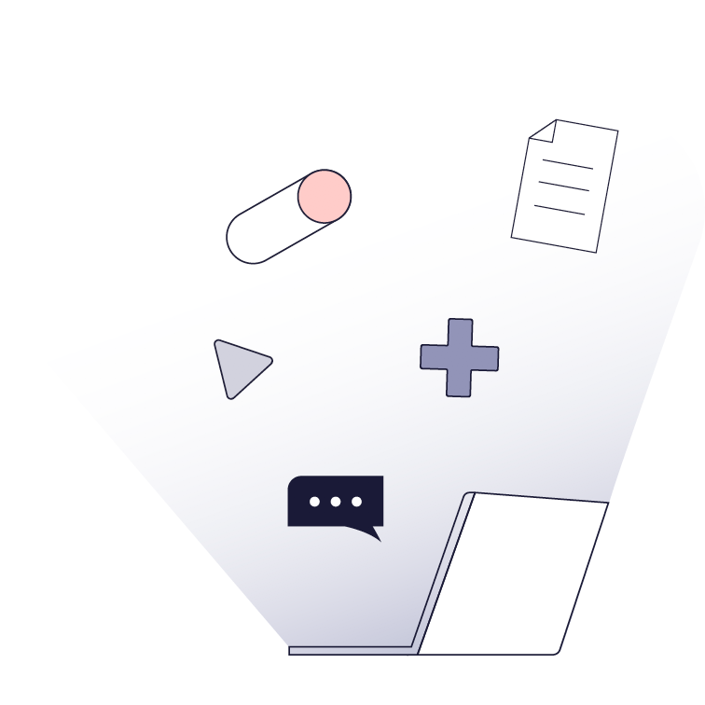
We have already stated what we want..
We want to prevent early leavers!
We want to ensure that new hires are engaged and excited about their new job and workplace!
We want to speed up time-to-productivity!
We want to retain both new and existing employees as long as possible!
We want to save time and money on our recruitment and onboarding efforts all together!

Slide 27
Let’s start onboarding to get the most out of new hires!
>> Let’s get started

