Slide 1
Offboardig system
Your one click pitch template
>> Let’s start convince your boss

Slide 2
The cost of replacing an employee is expensive. Very expensive.

Slide 3
The cost of replacing an employee is expensive, in fact, it can add up to as much as 2x the employee’s annual salary! There are several reasons for this; Recruitment costs for hiring a replacement, new hire onboarding, training, new hire time-to-productivity, the loss of the former employee’s knowledge and know-how, new tech, subscriptions, etc. etc.
And then there are factors like our employer branding and employee value proposition, that can suffer tremendously from employees leaving on a bad note.
It’s time to offboard!

Slide 4
Let’s flip that around
Do we want to safeguard knowledge and ensure knowledge transfer from leavers?
Do we want to avoid IT security and confidentiality breaches?
Do we want to protect our employer brand when someone leaves our organization?
Do we want to treat leavers with dignity and respect?
Do we want to leave the door open to boomerang employees whenever possible?

Slide 5
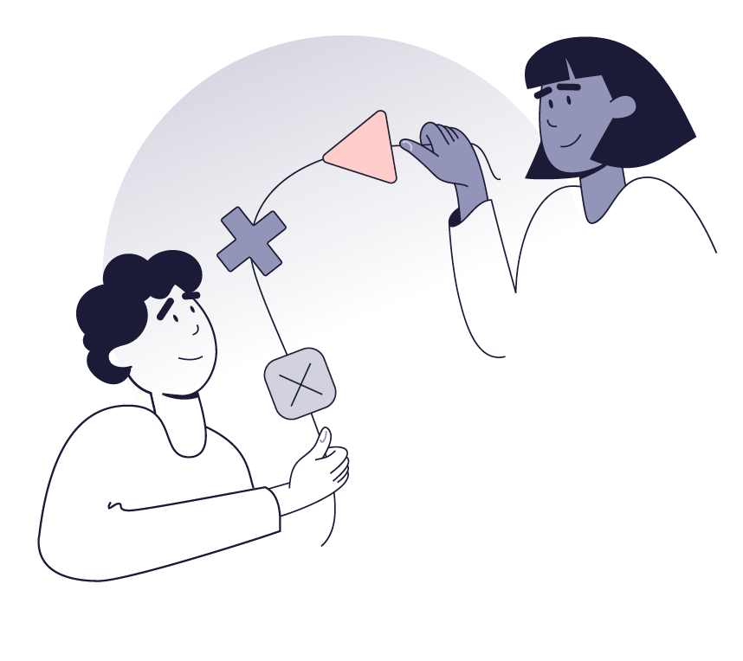
Here’s a way for us to ensure professional exit management that pays off
Digital offboarding system
With digital offboarding software we can set up formal offboarding procedures to ensure proper knowledge transfer from leavers to new employees.

Slide 6
What will this do for us?

Slide 7
7
1
Safeguard knowledge and know-how
With a digital offboarding system we will be able to ensure and manage knowledge transfer and administrative offboarding tasks in a streamlined and automated setup ensuring that we safeguard knowledge and avoids data and IT breaches.

Slide 8
The cost of replacing an employee can range from 1,5-2 times their annual salary.
2x

Slide 9
71% of organizations have no formal offboarding process.
71%

Slide 10
10
2
Ensure valuable feedback
With a digital offboarding system we will be able to get valuable feedback from leavers that we can improve and grow from. Feedback from leavers is essential knowledge for both HR and management that will allow us to meet goals and expectations going forward.

Slide 11
52% of voluntary leavers say their workplace could have done something to stop them from leaving.
52%

Slide 12
51% say that no manager or leader talked to them about their job satisfaction or future in the 3 months before leaving
51%

Slide 13
13
3
Improve employer brand
With a digital offboarding system we will be able to offboard with respect and dignity, regardless of the reason for leaving. And with professional offboarding processes and human communication and feedback we can ensure to show leavers that we’ve valued their work and even encourage them to return some day.

Slide 14
40% would consider boomeranging back to a former employer. Something that would save us 1/3 - 2/3 on recruitment costs.
40%

Slide 15
80% say no strategy were in place at their previous workplace to encourage them to return.
80%

Slide 16
64% say there did not seem to be a strategy for maintaining a relationship with them.
64%

Slide 17
To sum up A digital offboarding system will enable us to safeguard knowledge and knowhow while minimizing data loss and IT security breaches. Feedback from leavers will enable us to improve going forward and we’ll show leavers that we’ve valued their work. We’ll increase the likelihood of leavers recommending us as employer and maybe even returning one day.

Slide 18
…And there is more!

Slide 19
It’s like a digital HR assistant
Digital and automated processes will free up internal resources
No internal IT resources needed for daily usage
We’ll have free local support every day from 8-17
We’ll have access to consultancy if needed

Slide 20
And in case you wonder…
Yes,
It is 100% GDPR compliant
We’ll always have candidate & employee consent
We’ll have deletion policy & user management in place
Vendor is under IT audit by external IT revisions
We’ll have secure data storage
Data processor agreement from vendor is our guarantee

Slide 21
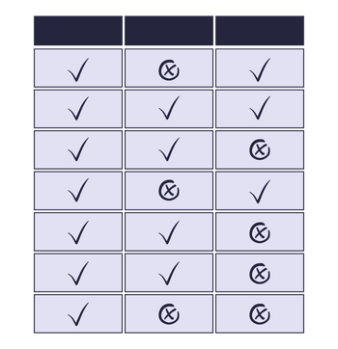
To make it even more simple, I’ve listed the system requirements we need to succeed See overview

Slide 22
We have already stated what we want..
We want to safeguard knowledge and ensure knowledge transfer from leavers?
We want to avoid IT security and confidentiality breaches?
We want to protect our employer brand when someone leaves our organization?
We want to treat leavers with dignity and respect?
We want to leave the door open to boomerang employees whenever possible?

Slide 23
Let’s start protecting
our business with offboarding
>> Let’s get started

